Slide 1



Enhancing Uncertainty-Based Hallucination Detection with Stronger Focus
Tianhang Zhang, Lin Qiu, Qipeng Guo, Cheng Deng, Yue Zhang, Zheng Zhang, Chenghu Zhou, Xinbing Wang, Luoyi Fu

Slide 2

Background
Hallucination in LLMs
the generated content that is nonsensical or unfaithful to the provided source content [37, 90, 100, 168], is the most inclusive and standard. However, there do exist variations in definition across NLG tasks, which will be further described in the later task-specific sections.
According to Ji et al.[1], hallucinations in NLP tasks refer to the generated content that is nonsensical or unfaithful. However, there do exist variations in definition across NLG tasks, such as subjective errors.
[1]. Ji Z, Lee N, Frieske R, et al. Survey of hallucination in natural language generation[J]. ACM Computing Surveys, 2023, 55(12): 1-38.

Slide 3
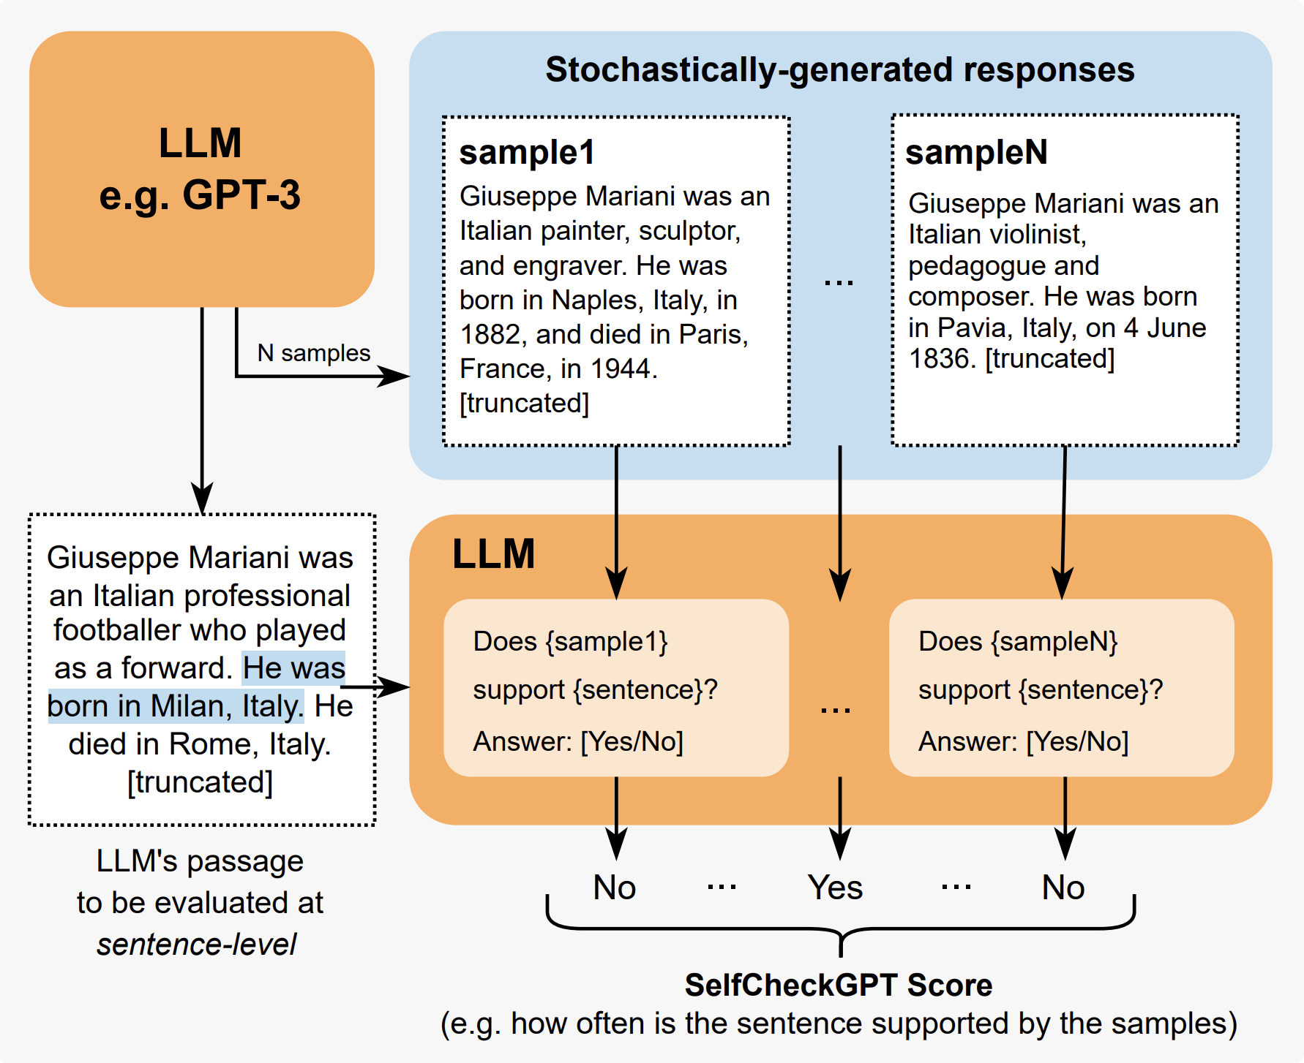
Related work
Sampling based
SelfCheckGPT [2]:
Sample multiple responses from the same LLM.
Check information consistency.
BERTScore, QA, n-gram model, prompting…
Cost-heavy!
[2]. Manakul P, Liusie A, Gales M J F. Selfcheckgpt: Zero-resource black-box hallucination detection for generative large language models[J]. arXiv preprint arXiv:2303.08896, 2023.

Slide 4
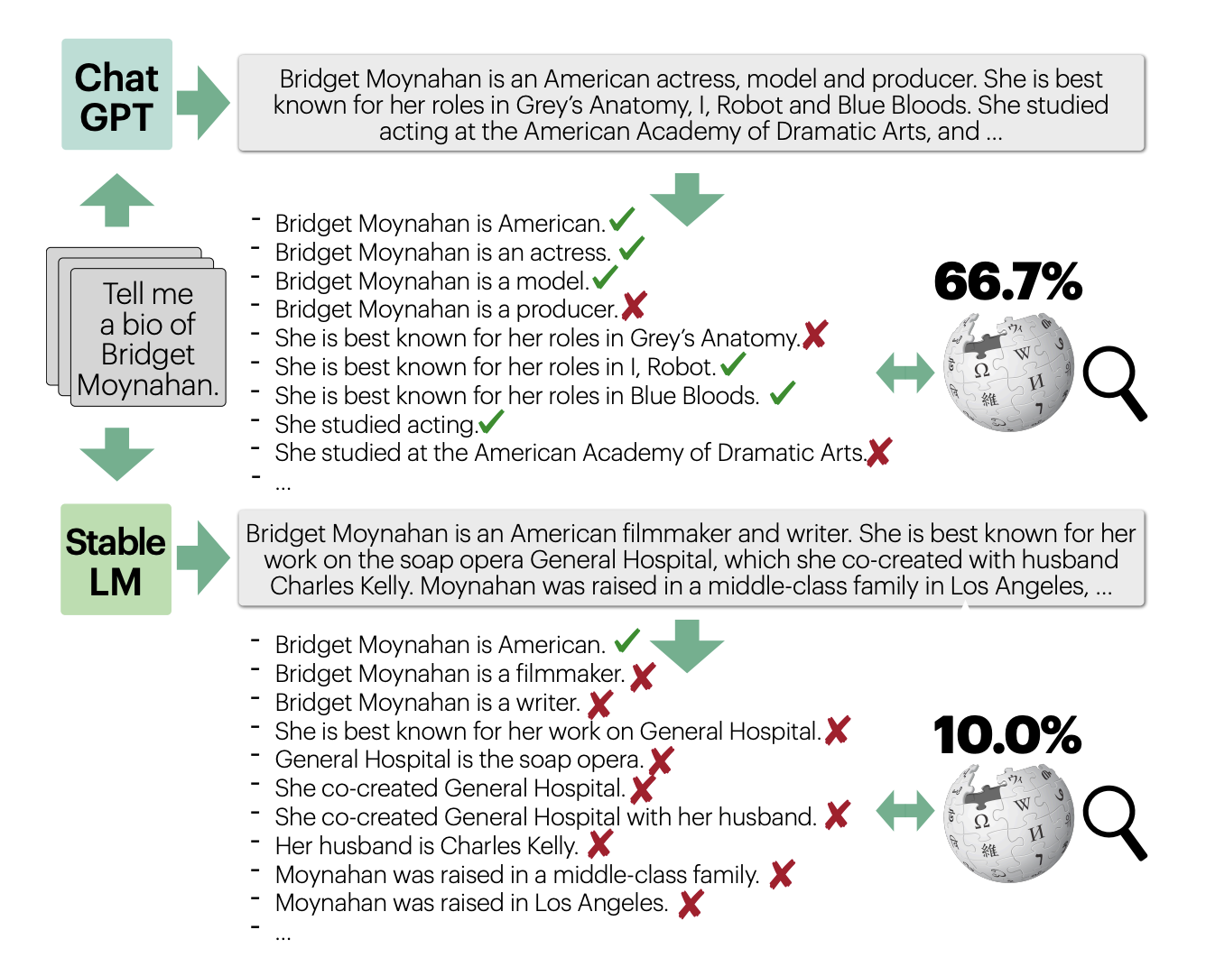
Related work
Retrieval based
FActScore [3]:
Extract atomic claims from the response.
Check the correctness of each claim.
Calculate the fraction of atomic claims supported by a given knowledge source.
Need extra knowledge source!
[3]. Min S, Krishna K, Lyu X, et al. FActScore: Fine-grained Atomic Evaluation of Factual Precision in Long Form Text Generation[J]. arXiv preprint arXiv:2305.14251, 2023.

Slide 5
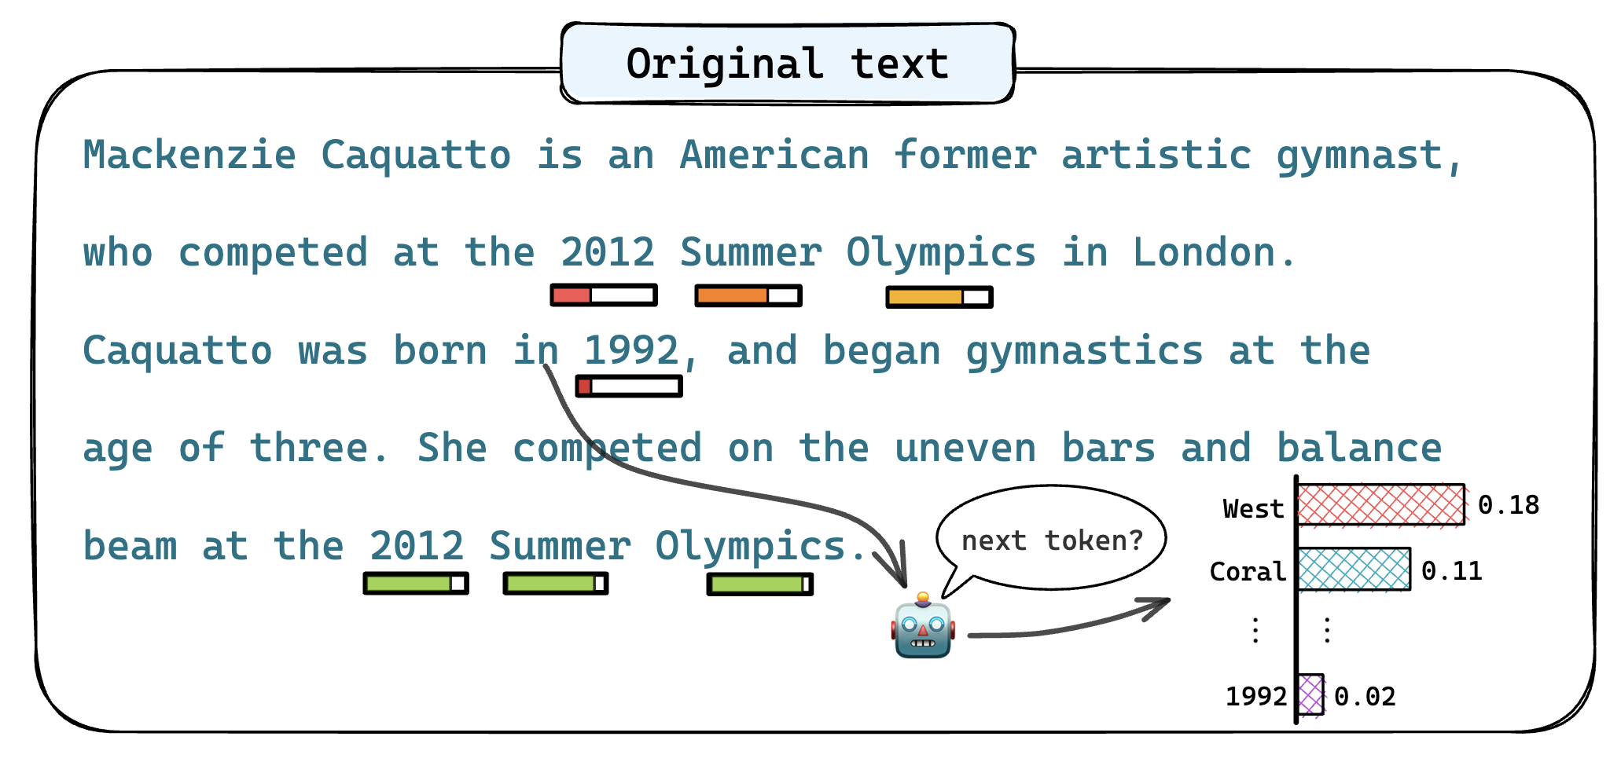
Our methods
Uncertainty based
Given a model response, calculate the generation probability of each token. If the response is from a black-box LLM, we can use a proxy model for estimation.
However, such method may introduce noise when calculating sentence-level hallucination scores.
The probability may exhibit "overconfidence”.
The probability sometimes demonstrate "underconfidence"

Slide 6
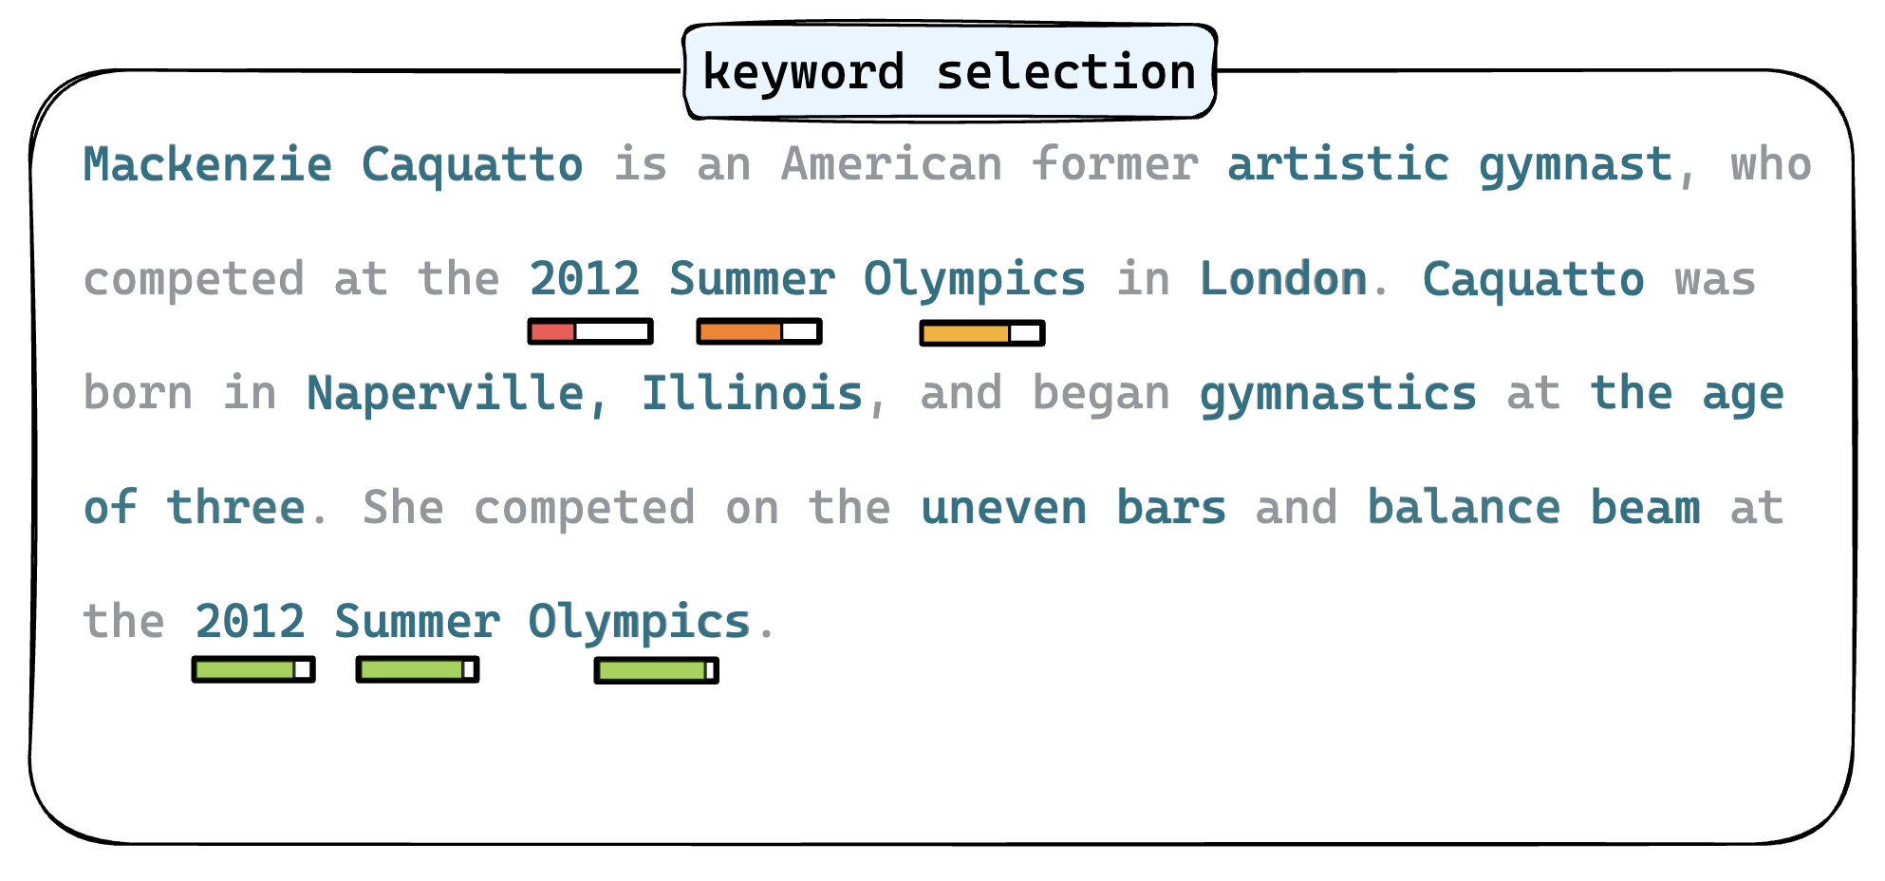
Our methods
Keyword selection
The keywords that express salient information will be extracted for the calculation of hallucination scores at both sentence-level and passage-level.
The keywords are the named entities and nouns recognized by Spacy.

Slide 7
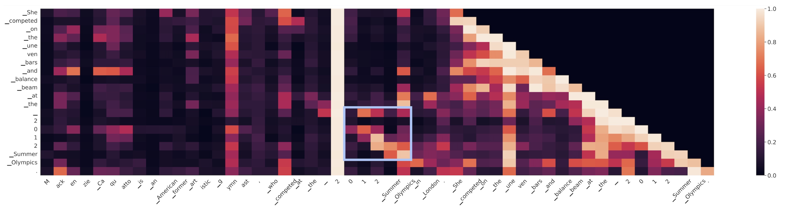
Our methods
Penalty transmission
Considerable attention is given to the same phrase in the first sentence (circled with a blue box) when generating “2012 Summer Olympics” in the last sentence.
However, the claim “Mackenzie Caquatto competed at the 2012 Summer Olympics in London” is untruthful

Slide 8
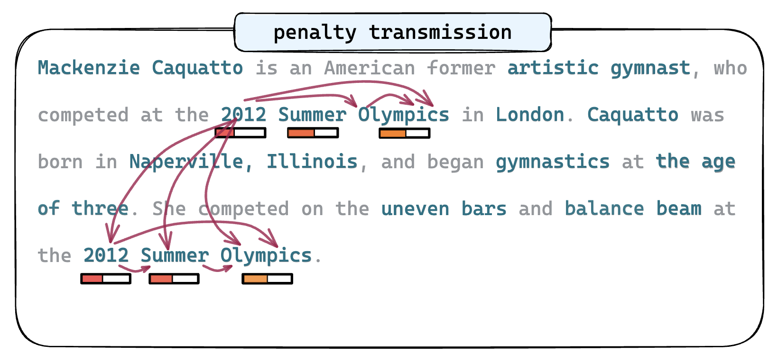
Our methods
Penalty transmission
We propagate the uncertainties of previous tokens to the subsequent ones according to their attention weights.
The attention weight is the max-pooling results for all the layers and attention heads.

Slide 9
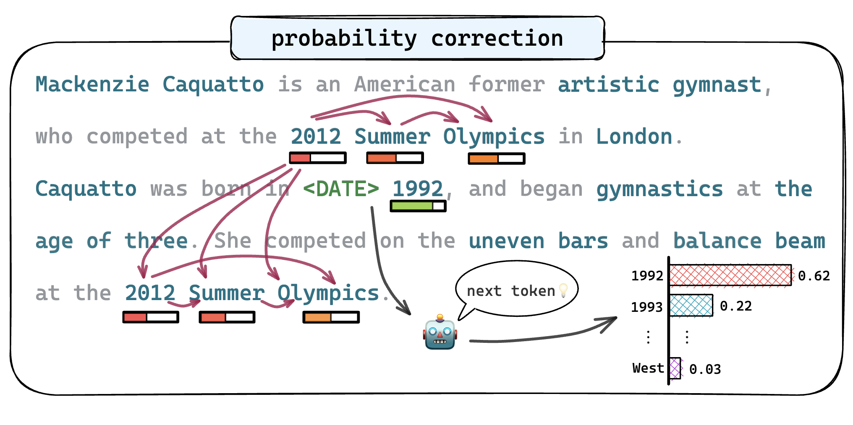
Our methods
Probability correction
The predicted token probability is conditioned on its entity type (if any) and adjusted by its inverse document frequency (IDF).
The token frequency is estimated using the sampled RedPajama[4] dataset.
[4]. https://huggingface.co/datasets/togethercomputer/ RedPajama-Data-1T-Sample

Slide 10
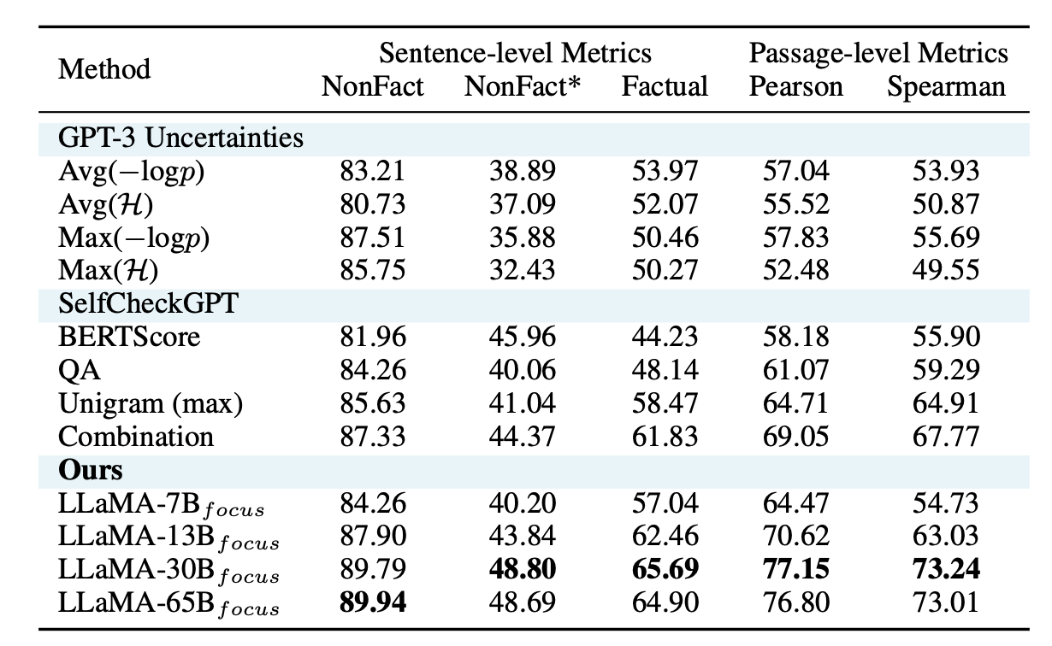
Experiments
Detection in LLM
Our proposed method achieves SOTA performance on the WikiBio GPT-3 dataset across various models with different scales.
Our method show effectiveness across 19 different proxy models such as OPT, GPT-J and Falcon.
Our approach does not require additional sampled responses or external knowledge bases.

Slide 11
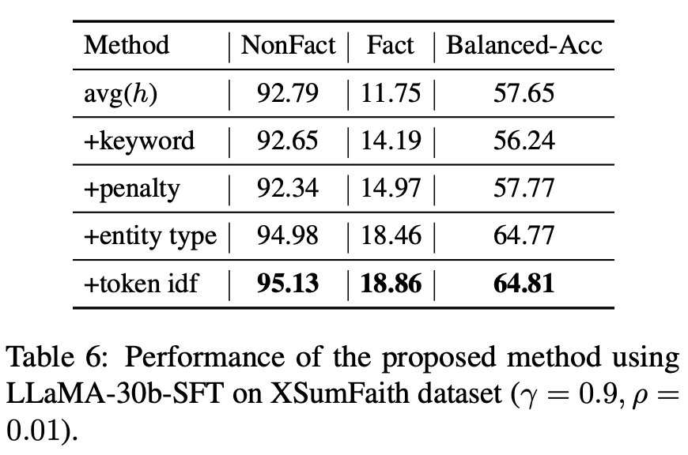
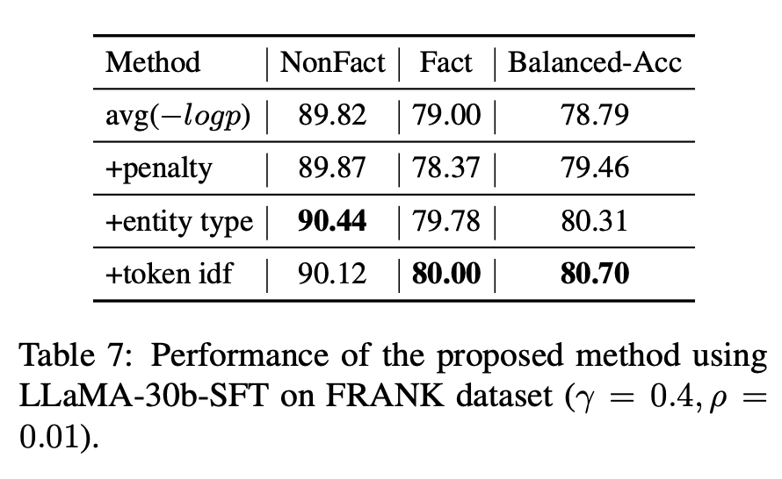
Experiments
Detection in small models
We evaluated our method on XSumFaith and FRANK dataset, which contains summaries generated by snall models such as TransS2S[5], TCONVS2S[6], and BART[7].
As shown in the table, our method also shows effectiveness in detecting hallucinations within summaries generated by small language models.
[5]. Vaswani A, Shazeer N, et al. Attention is all you need[J]. Advances in neural information processing systems, 2017, 30.
[6]. Narayan S, Cohen S B, Lapata M. Don’t Give Me the Details, Just the Summary![J]. Topic-Aware Convolutional Neural Networks for Extreme Summarization. ArXiv, abs, 1808.
[7]. Lewis M, Liu Y, Goyal N, et al. Bart: Denoising sequence-to-sequence pre-training for natural language generation, translation, and comprehension[J]. arXiv preprint arXiv:1910.13461, 2019.

Slide 12

Q&A
XXXXX答辩，如果不需要可以删除

Slide 13
Thanks!

